Slide 1
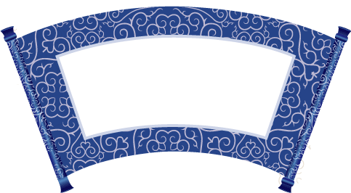
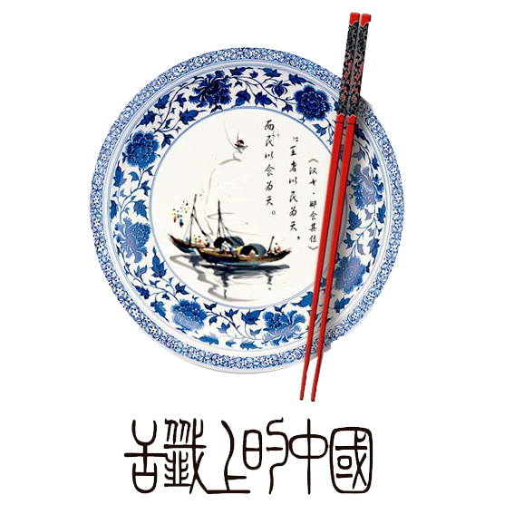


Chinese dinging manners

Slide 2
01
Reason
Contents
02
Basic Rule
03
The Setting
04

Slide 3
Reason

Slide 4
Basic Rule
formal seating
simply relax, observe
Your hosts will understand your nervousness. They‘ll most likely do everything they can to prevent any loss of face to all parties at the table. The guest must accord to the host what he likes.(客随主便)
normal seating
lead the way

Slide 5
The Setting
host
guest1
guest2
Table
guest3
In Chinese culture, the chair facing the entrance (or east, if possible) is known as the "command seat " the Eastern equivalent to "the head of the table.
--尚左尊东、面朝大门为尊
guest4
guest5
guest6
companion
Entrance

Slide 6
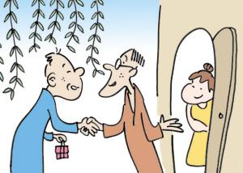
Dining at someone’s home
Sometimes, people are invited by their friends to have dinner at their home. For such an invitation, knowing some rules for dining is always necessary.
•Rise when introduced to guests
•Don’t arrive empty-handed
•Eat and praise the host
•Leave one’s shoes at the door
•Wait for the eldest or most senior person
•Hold your glass with your right hand
•Keep your chopsticks in a correct place

Slide 7
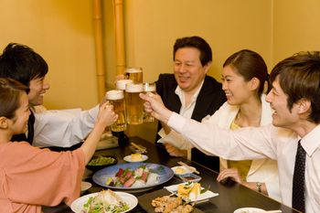
Chinese Drinking Etiquette
As with eating, drinking is done communally and follows some loose etiquette.
Hold your glass slightly lower than theirs to clink
Someone older
Someone of higher status
Do not drink alone
Wait until a toast is given
Drink with the group.
Get Out of Drinking in China
Use little white lies on such occasions to save face
Women are often excused from drinking more easily than men

Slide 8
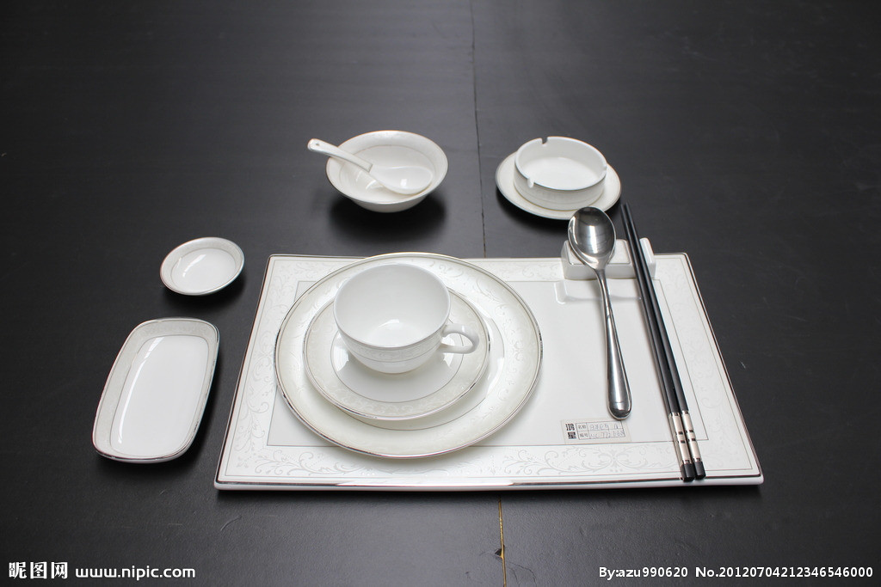
Dining with Chinese cutlery
Chopsticks: only clip food
put down the chopsticks when talk with others
never insert the chopsticks into the food vertically
Plate (食碟): pack food from the public plate
pack the residue of food
take a new one if full
Toothpick: don’t use it in public (use a hand to cover the mouth)
don’t hold it in the mouth
Spoon: put it on the 食碟 when you don’t use it
Bowl: don’t lift up the bowl
use cutlery to eat food from it
don’t put it upside down on the table

Slide 9
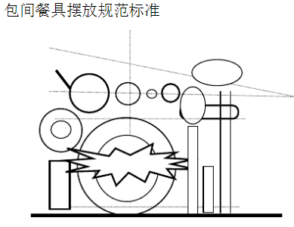
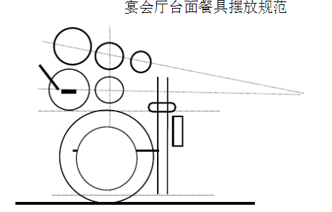
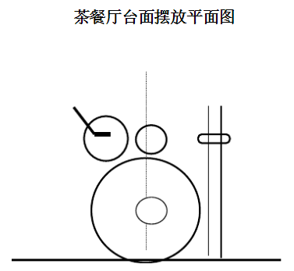
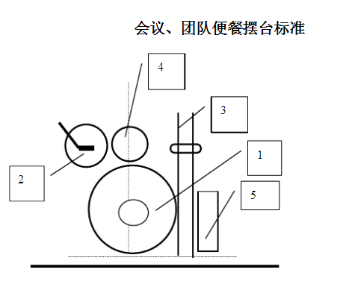
Cutlery setting

